Slide 1


AirBnB Home Rental Analysis

Slide 2

Presented By
Bhukya Mounika
Bishal Paul
Kammari Vinay
Sandip Bhattacharya

Slide 3

About AiRBnB
Airbnb Inc. is an American company that operates an online marketplace for lodging, primarily homestays for vacation rentals, and tourism activities. Based in San Francisco, California, the platform is accessible via website and mobile app.
The company operates in the following regions :-
Europe
United States
Japan
Singapore
China

Slide 4

SEATTLE
Seattle is a seaport city on the west coast of United States. It is the seat of King Country, Washington. It is the largest city in both the state of Washington and the Pacific Northwest region of North America.
Top Tourist attractions :-
Chihuly Garden and Glass
Museum of pop culture
Space Needle
Discovery Park
Olympic Sculpture Park
Smith Tower
Seattle Great Wheel
Lake Washington

Slide 5
OBJECTIVES OF THIS PROJECT :
Finding particular trend and seasonal pattern by analyzing the revenue data for past years and we are trying to forecast the possible revenue during specific seasons in the coming future.
To predict the type of property that a customer is looking for as per their requirement. This way, the search for the property can be narrowed down by focusing only on the particular property type.
Building a recommendation system for customer that can suggests them top properties as per their requirements.

Slide 6
STREAM OF WORK
INFO GATHERING AND VISUALISATIONS FROM RAW DATA
PROPERTY REVENUE PREDICTION USING TIME SERIES ANALYSIS
PREDICTING PROPERTY TYPE BASED ON SELECTED FEATURES
BUSINESS SUGGESTIONS FROM INFERENCES
Visualizing and finding any existing trends or seasonality
-------------------------------
Forecasting the property price based on the past records.
Understanding the dataset.
------------------------------
Preprocessing the data
-------------------------
Exploratory Data Analysis.
Building a classification model to predict the property type based on the required input parameters from the customer.
Put forward the insights and suggestions after the analysis of Seattle’s dataset in-order to help AirBnB maximize its revenue.

Slide 7
DATA PREPROCESSING
Our data has 3818 rows and 92 columns.
Columns like price, security deposit, cleaning fee, weekly-price and monthly-price were in object type, so we converted them to float types.
Important columns having null values :-
Host response rate, Host is superhost, Host listing count, Host identity verified, Property type,
Bedrooms, Bathrooms, Security Deposit, Weekly and Monthly price and other columns based on reviews.
Balancing null values :-
Columns like host response rate, security deposit, cleaning fee have been filled with 0.
Entries from columns which had less than 20 null values like Bedrooms, bathrooms, etc. were dropped as they were negligible.
Columns based on reviews were filled with mean values.
Weekly and monthly price columns were filled taking data from price column.
All other irrelevant columns were dropped.

Slide 8
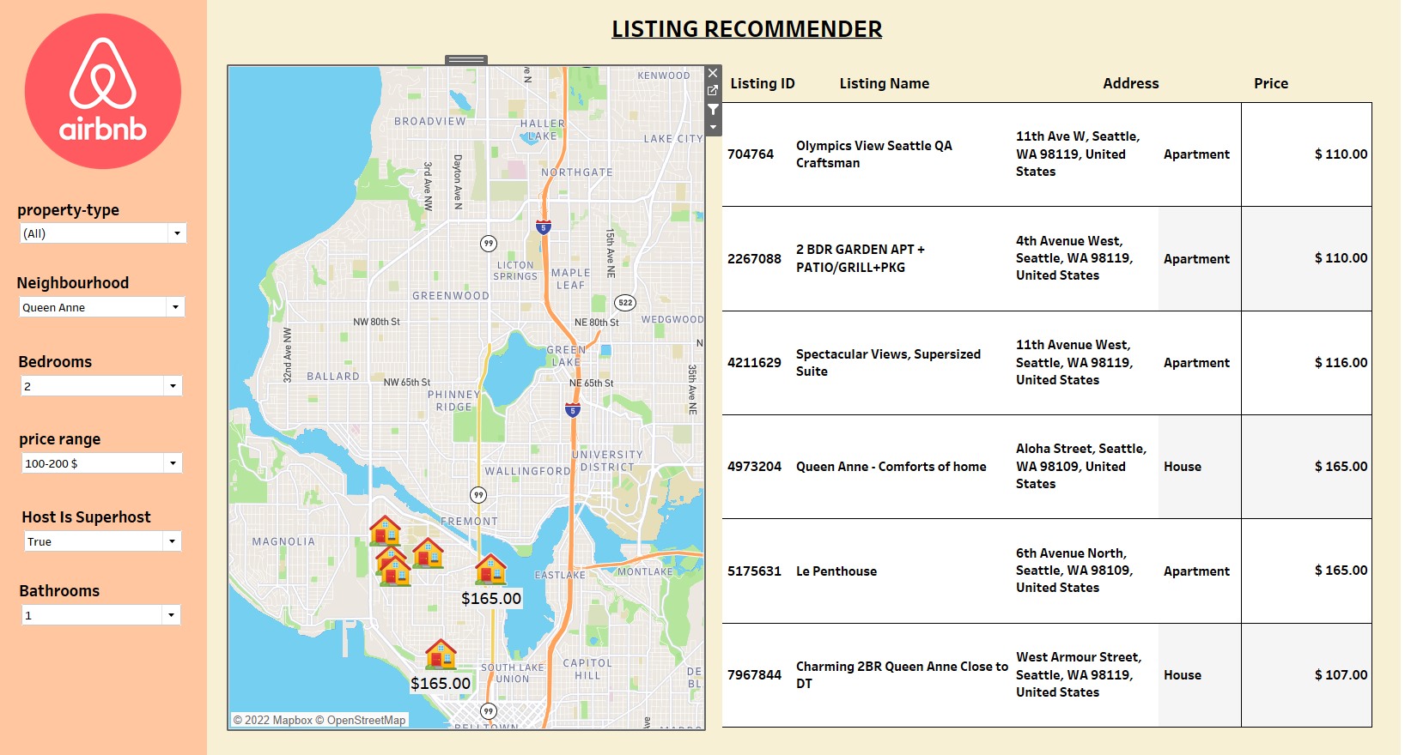

Slide 9
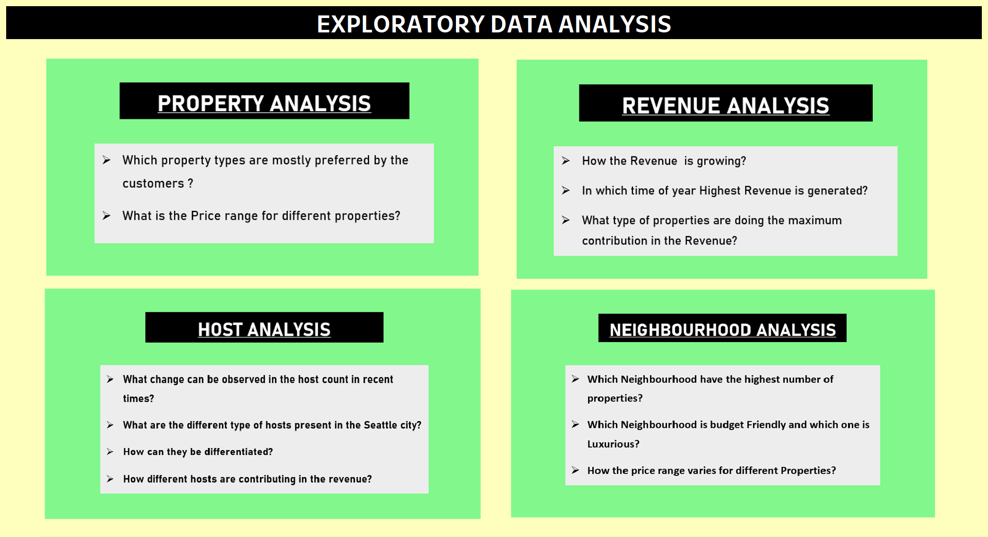

Slide 10
Objective
TIME SERIES ANALYSIS
Identify if there are any trends and seasons when travelers book these accommodations, Analyze and try to forecast revenue.

Slide 11
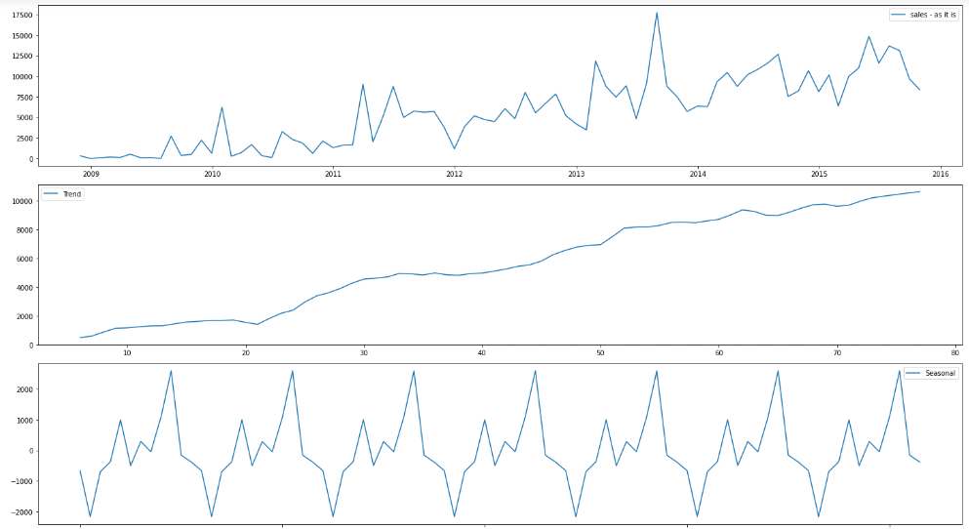
What are the characteristics of AirBnB over the time period
Feature selected: host since(Date) and price(Revenue)
Checking for the trend and seasonality
Data shows upward trend over time period
That means Airbnb is having growth over 2009 -2016
Data also shows there is a seasonality
It shows in a particular season revenue are higher than usual

Slide 12
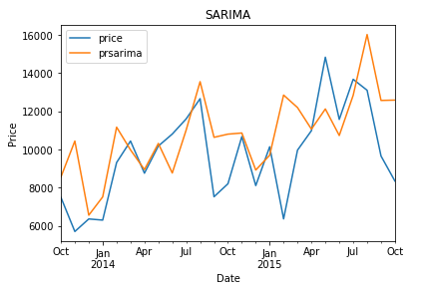
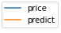
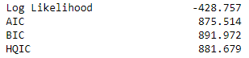
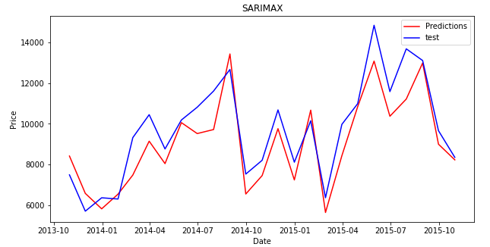
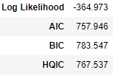
Models for the Timeseries
SARIMA(Seasonal Autoregressive Integrated Moving Average):this model will take seasonality patterns into consideration for the prediction from previous data
SARIMAX(Seasonal Auto-Regressive Integrated Moving Average with exogenous factors):This model is similar to SARIMA but this model considers other dimensions which are having high correlation with target component

Slide 13
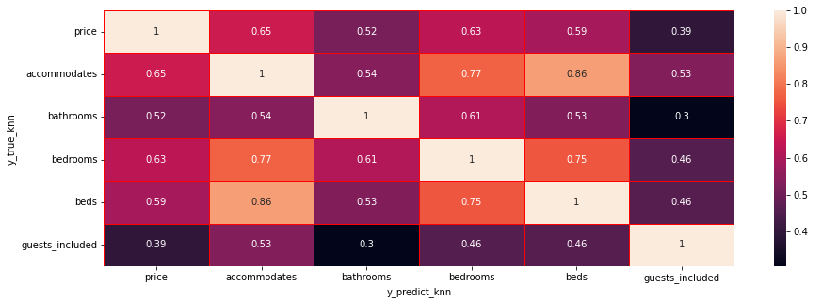
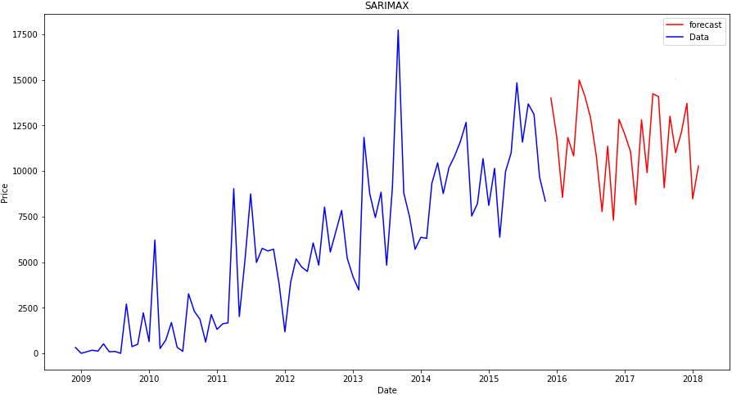
Variables used for Exogenous Factors
Exogenous variables: Accommodates, bedrooms, bathrooms, beds, guests included
These variables are having high correlation which will influence the price
Forecasting using SARIMAX
Forecasting for next two years
It’s also showing the seasonality and trend for two year

Slide 14
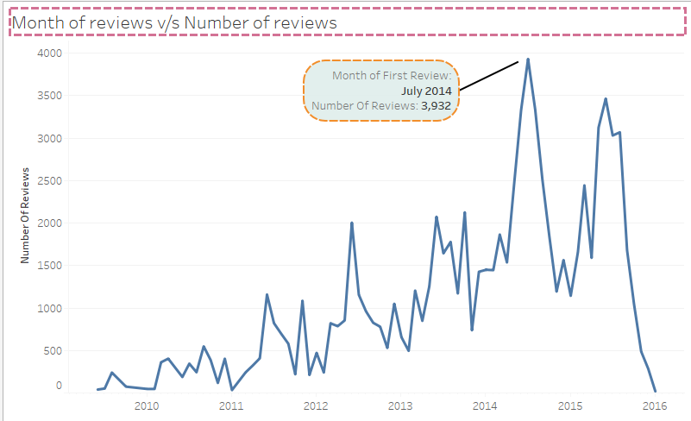
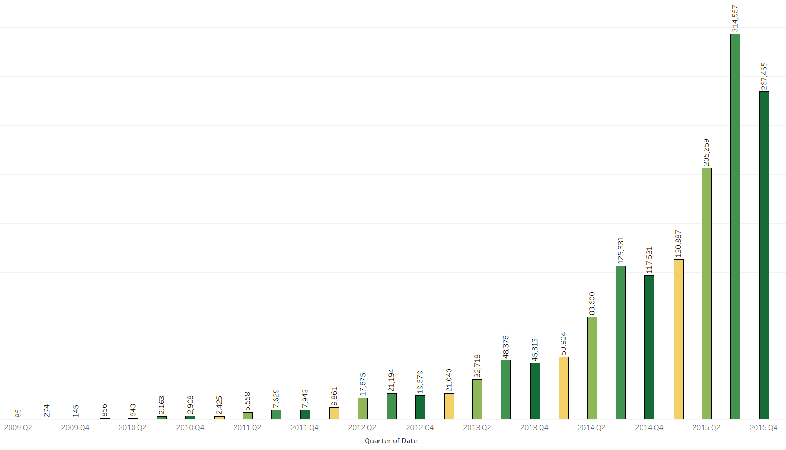
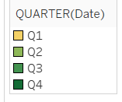
Let’s get little detailed in this seasonality, Which gives insights and helps in the further growth of Organization
The no. of reviews are making the peaks on every July and August(every 3rd quarter of year)
It shows that every year large no. of people visit Seattle city in the July and august
This is because of the Seattle tradition of hydroplane race and Navy’s Blue Angles fly’s ,its held in starting month of summer
Most of the people comes to visit Seattle tradition also called Seafair festival, as climate will also be warm to visit

Slide 15
Business uses and Advantages
How can we make Airbnb more popular and increase the growth in Seattle city (using Seafair festival)
By advertising before the month of July and august (before Seafair festival)
Offering few discounts which will attracts the customers
Host should be active and response time should be good in these 2 months

Slide 16
PROPERTY TYPE PREDICTION

Slide 17
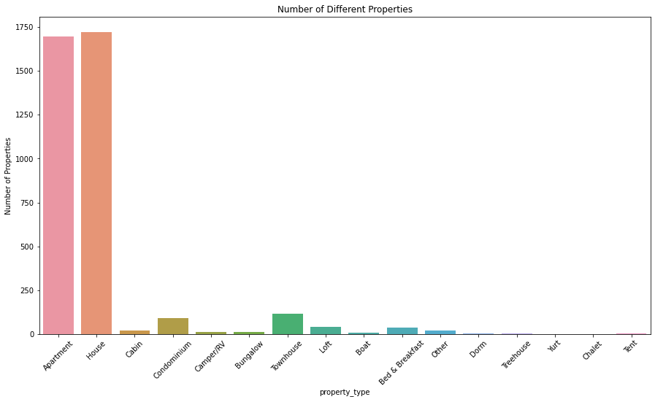
Objective : Build a Classification model that will predict the ‘property type’ a customer is most likely to select, given a set of input features from the customer.
Except House and Apartment type, all other property types have very less data which makes it underfit for analysis.
Townhouse is merged with House.
Rest of the property types are neglected

Slide 18
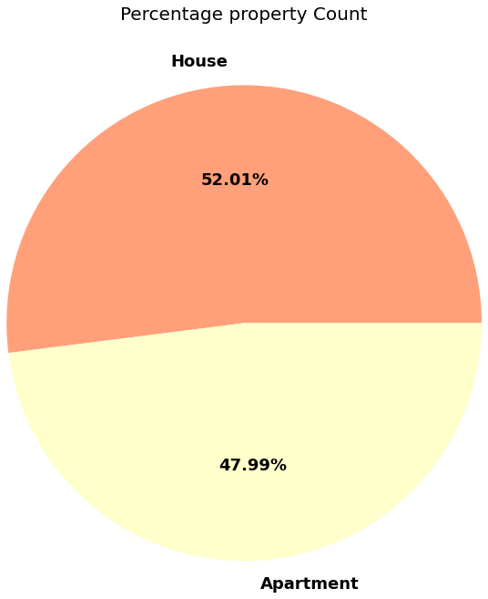
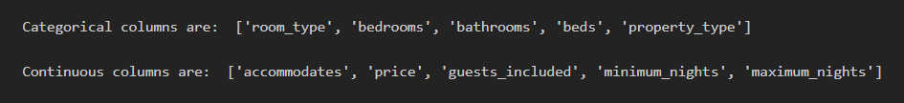
After removing irrelevant property types finally we saw we have two main property types House and Apartment which are approximately in 1:1 ratio which indicates that our data is well balanced.
FEATURE SELECTION
For our model we have considered 5 categorical columns and 5 numerical columns out of total 92 columns present in the given dataset. The selected columns are shown below :-

Slide 19
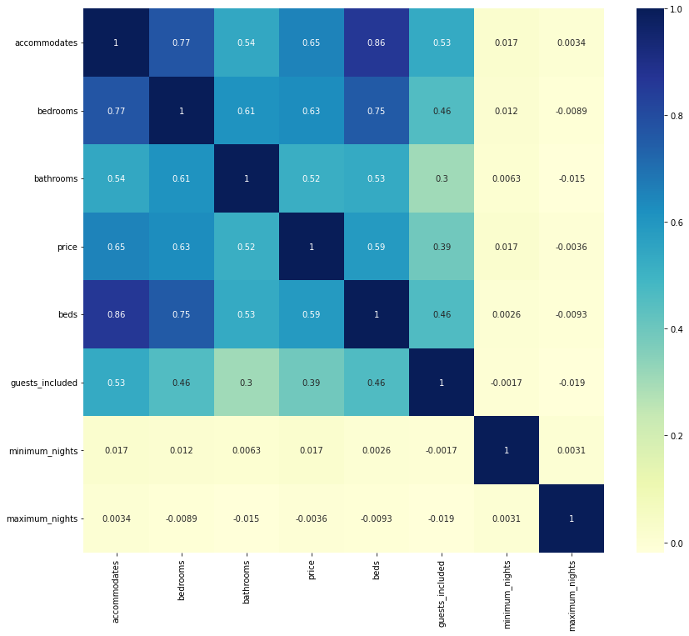
CHECKING COLLINEARITY
We are ignoring accommodates and beds to avoid multicollinearity

Slide 20
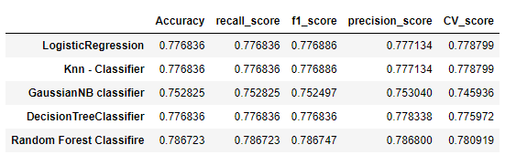
COMPARISON OF DIFFERENT CLASSIFICATION MODELS
Since all the classifier models are giving similar accuracy and CV scores, we can state that our data is well balanced.
Random Forest Classifier’s accuracy is a bit better than other models, so we will predict our property type using Random Forest Classifier.

Slide 21
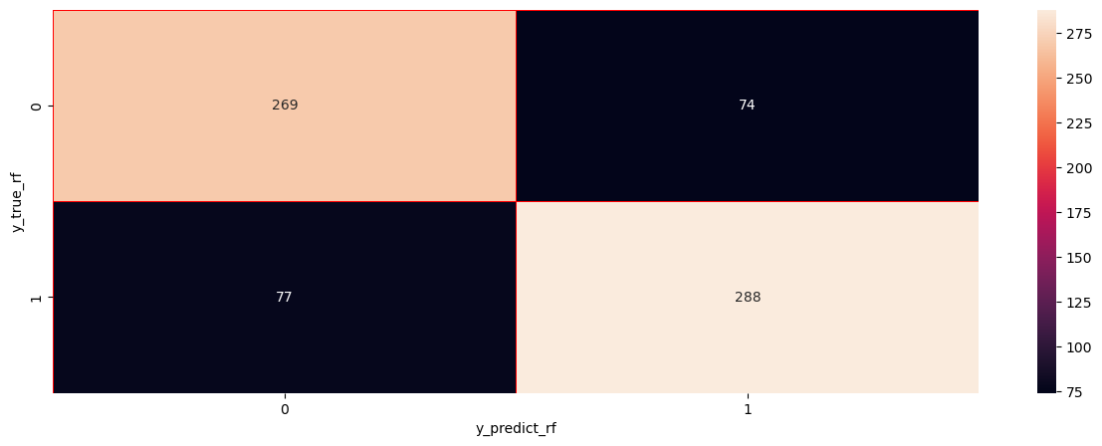
CONFUSION MATRIX
After selecting the final model, we are getting 79% accuracy . CV score is also 78%. So our model is well fitted.
Out of 708 instances, the model is predicting 557 instances correctly which is a significant amount.
apartment
house
apartment
house

Slide 22
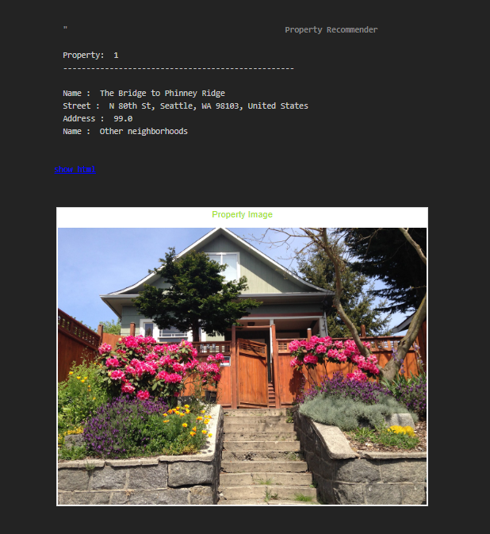
SEARCH ENGINE FOR PROPERTY RECOMMENDATION
We have a created a search engine model for property recommendation
Here is a demo of the model tried earlier.

Slide 23
FINAL CONCLUSIONS AFTER ANALYSIS :-
We should give more advertisements before the month of July as we have seen in our analysis
The hosts should be more active and responsive during the third quarter of the year.
We should encourage the hosts to opt for superhost policy for better ratings
Hosts should be verified so that customers can trust and book them as we observed that around 25 % of hosts were not verified. The highest revenue is being generated from verified hosts.
The increase in availability of internet globally has benefitted the growth of revenue for the company and we further hope to see the same increasing growth in terms of revenue.
Since majority bookings are done on house and apartment type in the previous years, we can tell the company to focus its services mainly on these two types so that our customers feel satisfied and visit us more in the future.

Slide 24

THANK YOU

